Slide 1




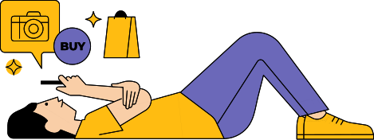
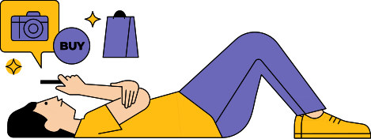
AUTOMATED CUSTOMER REVIEWS

Slide 2
OUR TEAM
Ghala
Razan
Essa

Slide 3
INTRODUCTION

Slide 4

In a world where digital reviews are growing every single day it’s becoming harder for businesses and users to keep up with the thousands of opinions shared online

Slide 5


But what if you could turn all that feedback into one smart recommendation?

Slide 6
THAT’S WHERE OUR PROJECT COMES IN
Using the power of Natural Language Processing (NLP) and Generative AI, we’ve built a smart review system that can:
01
02
03
Classifies reviews as positive, neutral, or negative
Group products into clear and meaningful categories
Summarize all the feedback into short, helpful recommendation articles

Slide 7
LOAD AND PREPROCESS THE DATA

Slide 8
Step 1: Load the Dataset
we used 4 Amazon review datasets:
1429_1.csv
All_Beauty.csv
Datafiniti_Amazon_Consumer_Reviews_of_Amazon_Products.csv
Datafiniti_Amazon_Consumer_Reviews_of_Amazon_Products_May19.csv

Slide 9
Step 2: Data Cleaning
We focused on two main columns:
rating and review.
The following preprocessing steps were applied to the review text:
Removed punctuation
Converted text to lowercase
Removed English stopwords
Applied lemmatization

Slide 10
CLASSIFICATION

Slide 11




Classifying Ratings into Sentiment Categories
Convert numerical ratings into meaningful sentiment categories
4-5
Positive
3
Neutral
1–2
Negative

Slide 12



Classifying Ratings into Sentiment Categories
Converting Sentiments into Numerical Values
Positive
Neutral
Negative

Slide 13
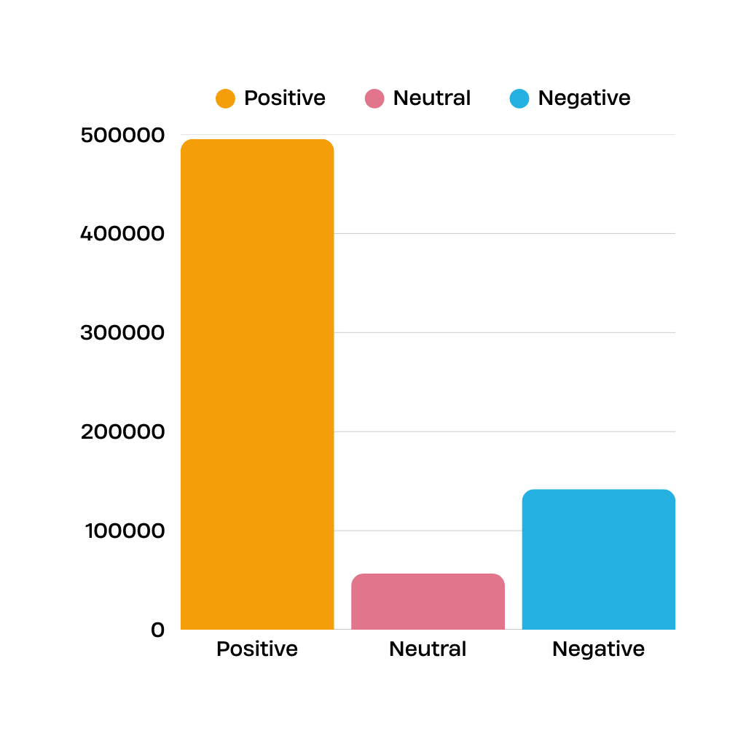
Balancing the Dataset
The original dataset was imbalanced across sentiment classes:
Positive: 495423
Neutral: 56702
Negative: 141816
This imbalance could negatively affect the model's performance by making it biased toward the dominant class (positive)

Slide 14
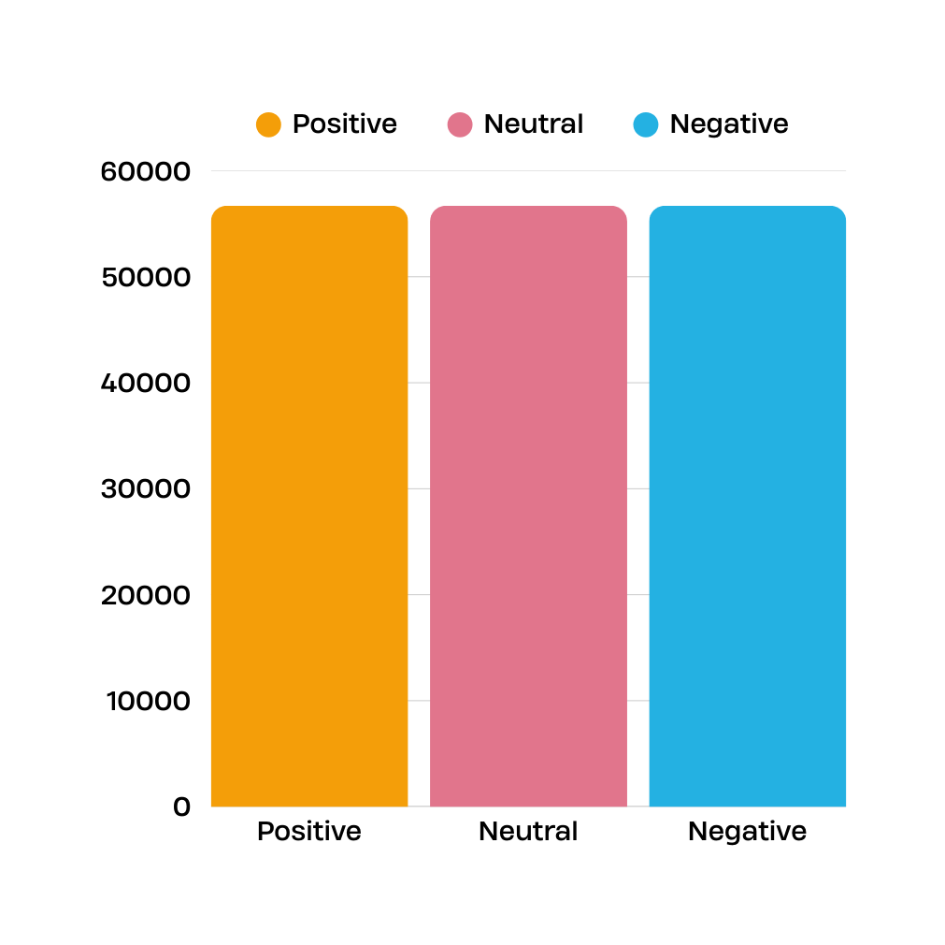
Balancing the Dataset
To address this issue, we applied balancing to ensure fair learning across all sentiment classes.
We selected an equal number of samples from each class to create a balanced dataset.
Total balanced dataset: 170106 reviews
(56702 Positive + 56702 Neutral + 56702 Negative)

Slide 15
ROBERTA MODEL FOR SENTIMENT CLASSIFICATION
03
01
02
Construct Train/Test Datasets
Define Evaluation Metrics
Tokenization
We used the roberta-base tokenizer to convert the training and test text data into input tokens
The data was wrapped into PyTorch datasets for both training and testing sets
We evaluated the model using accuracy, precision, recall, and F1-score per class (Negative, Neutral, Positive)

Slide 16
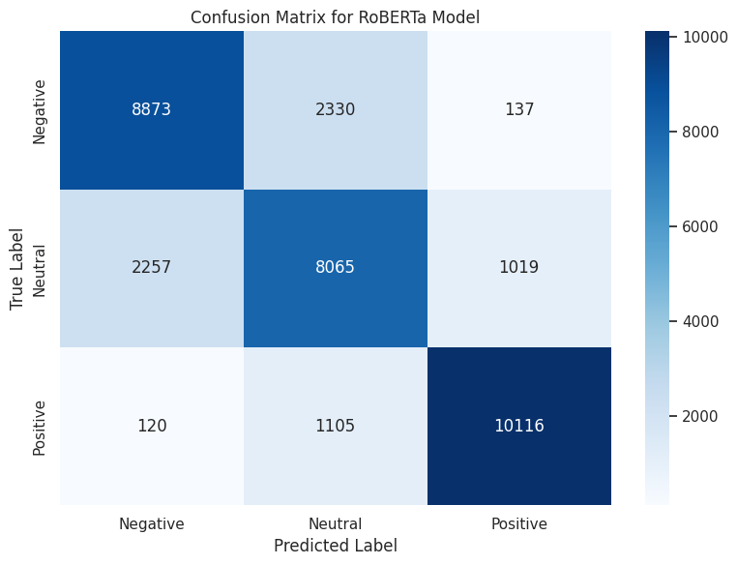
EVALUATION RESULTS
RoBERTa Classification Report:
Negative:
Precision: 0.7887
Recall: 0.7825
F1-score: 0.7856
Neutral:
Precision: 0.7013
Recall: 0.7111
F1-score: 0.7062
Positive:
Precision: 0.8974
Recall: 0.8920
F1-score: 0.8947

Slide 17
CLUSTERING

Slide 18

Product Name Embedding and Clustering with KMeans
We applied NLP techniques to understand and group product names and reviews. This process included converting text to numerical representations, clustering similar reviews, and visualizing the results.
We used a pre-trained NLP model to convert each product review into a vector a format that machines can understand and use for further analysis.
After converting the text to vectors, we applied the
KMeans algorithm to group similar reviews into 5
distinct clusters. Each cluster represents reviews
that talk about similar product experiences.

Slide 19
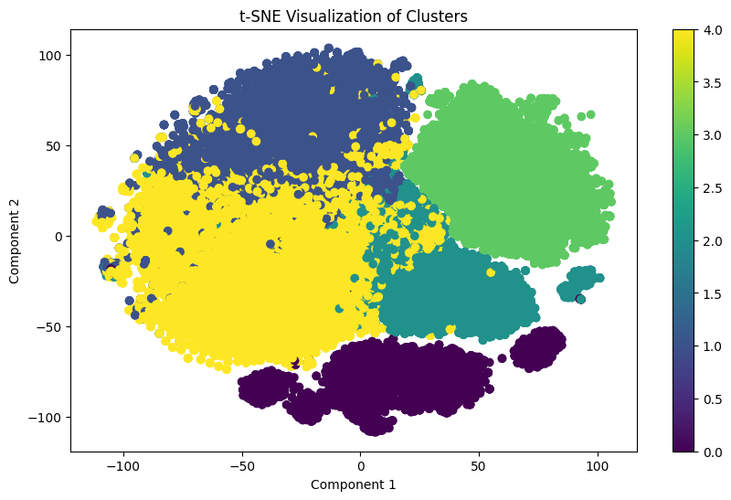
VISUALIZING CLUSTERS WITH T-SNE
We used the t-SNE algorithm to reduce the high-dimensional vector space into 2 dimensions, allowing us to visualize the clusters in a scatter plot.
This plot shows how the data points were grouped into distinct clusters, illustrating the structure within each group

Slide 20
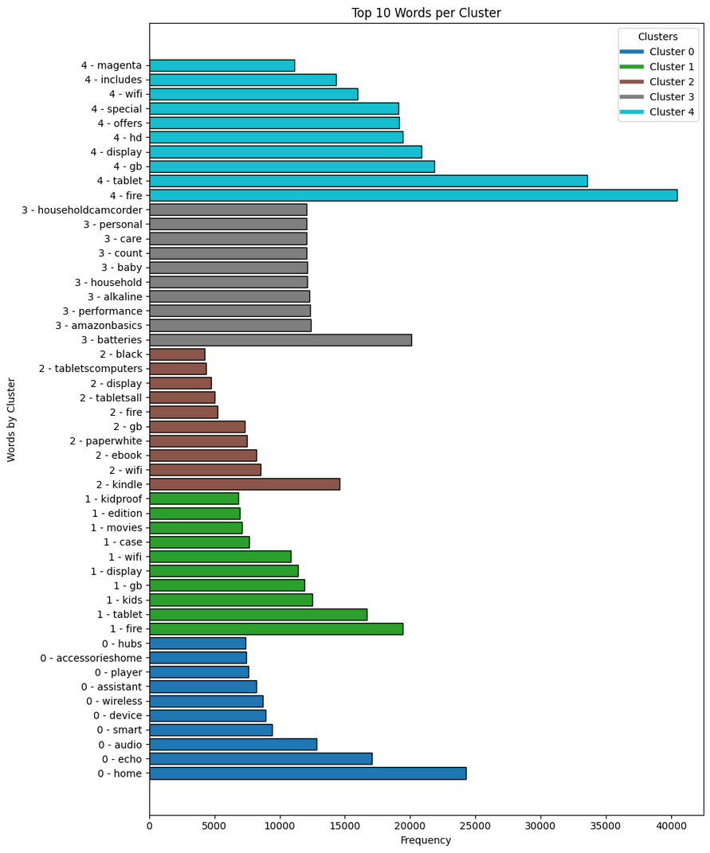
ANALYZING CLUSTERS
For each cluster:
Displayed 5 sample reviews.
Identified the most frequent words.
Plotted the top 10 most used words to understand the theme of the cluster

Slide 21
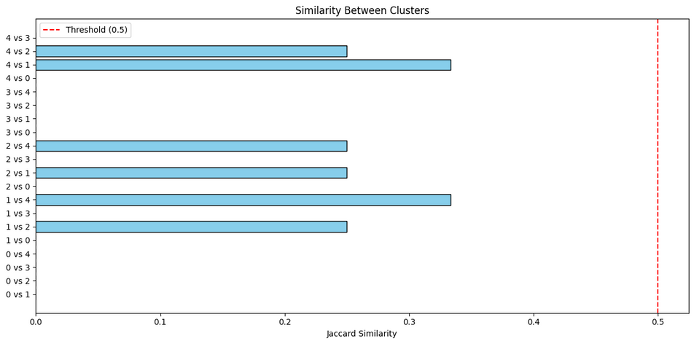
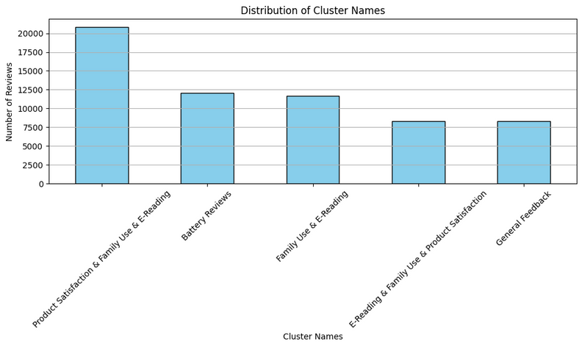
3. Similarity Between Clusters
After reviewing all the clusters, we noticed similarities between some of them.
Using the Jaccard similarity function, it was found that some clusters shared up to 30% similarity.
4. Merging Similar Clusters
Clusters with high similarity (based on top 10 words) were merged.
Each merged cluster was given a new name to better represent its theme.

Slide 22
SUMMARIZATION

Slide 23

SUMMARIZATION TASK
The goal of the summarization task was to generate article-style summaries for customer reviews across various product categories.
Each article includes:
The Top 3 products in a given category with customer highlights and complaints.
A summary of the Worst-rated product and why it should be avoided.

Slide 24
DATASET USED
For this task, I utilized the balanced_reviews_dataset, which was originally prepared and cleaned during the review classification task. This dataset includes:
Pre-labeled sentiment classes (positive, negative, or neutral)
Categories and primary categories
Product names
Star ratings
Review text

Slide 25
Models Used:
Initial Attempt – BART (facebook/bart-large-cnn):
We started with BART, a powerful encoder-decoder transformer model pre-trained for summarization.
However, it produced repetitive and often irrelevant outputs, especially with large concatenated texts.
Due to poor performance on this task we decided to try an alternative
Final Model – T5 (t5-small):
This model was able to produce high-quality content aligned with the article format.

Slide 26




Article for Category: Electronics
Top Products (Customer Favorites)
Fire Tablet, 7” Display
"Super lightweight"
"Easy on the eyes"
"Allows you to define words with a tap and saves them"
"Perfect for reading and learning"

Slide 27




Article for Category: Electronics
Worst Product (To Avoid)
OEM Amazon Kindle Power USB Adapter
"Overpriced (costs $19.99)"
"Feels like a scam"
"Didn’t need it — waste of money"
"A critical item sold separately — outrageous"

Slide 28

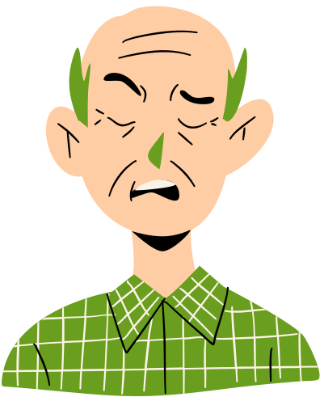


Article for Category: Electronics
Common Complaints
Amazon Echo Plus
"Built-in Hub is almost useless"
"Only discovered 2 out of 12 smart bulbs"
"Tried for 3 days — failed, but Hue Bridge worked instantly"
"Returned the product"

Slide 29
DEPLOYMENT

Slide 30

GOAL
Develop a web-based AI system to help businesses understand product performance through:
Sentiment classification
Product category clustering
AI-generated review summaries

Slide 31
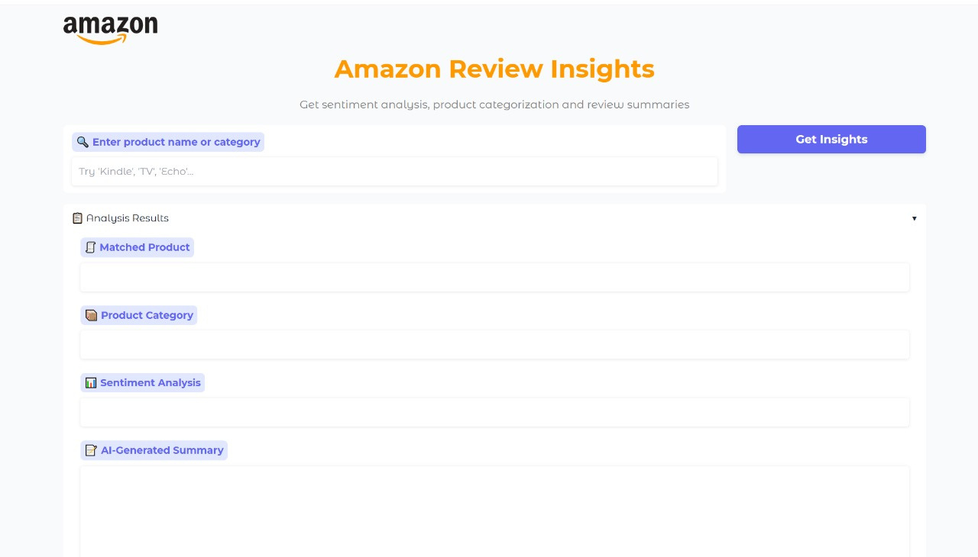

Slide 32

THANK YOU

